Slide 1
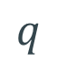
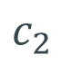
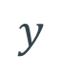
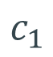




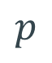

$$p$$
$$q$$
$$ω$$
$$y$$
$$γ$$
$$δ$$
$$c_{1}$$
$$c_{2}$$
$$s$$
$$t$$

Slide 2

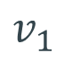

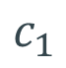


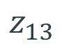

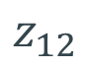

$$c_{1}$$
$$z_{13}$$
$$v_{1}$$
$$f$$
$$h$$
$$β$$
$$g$$
$$z$$
$$l$$
$$z_{12}$$

Slide 3
$$p$$
$$q$$
$$ω$$
$$y$$
$$γ$$
$$δ$$
$$c_{1}$$
$$c_{2}$$
$$s$$
$$t$$

Slide 4
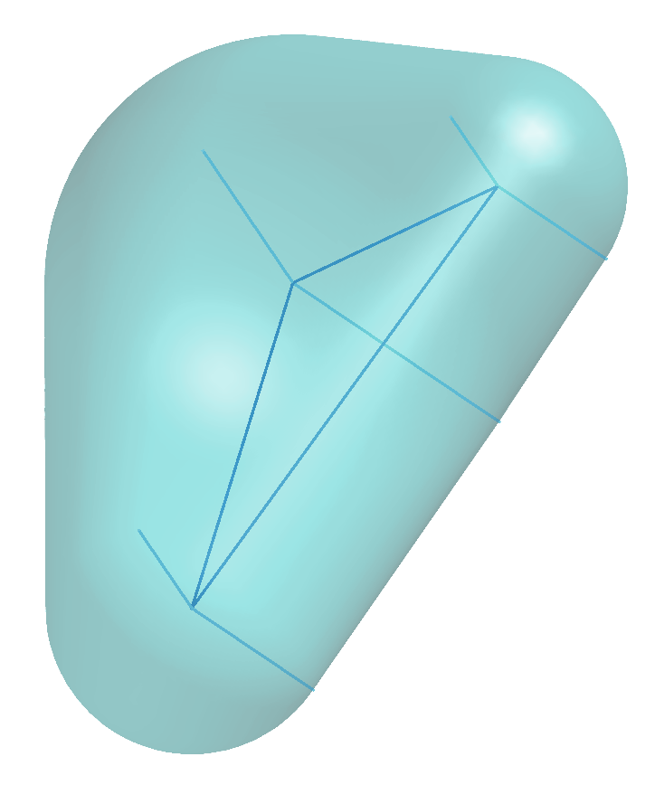
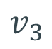


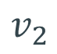
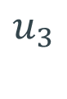
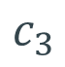
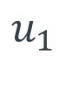
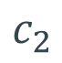
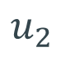
$$v_{3}$$
$$v_{1}$$
$$c_{3}$$
$$u_{3}$$
$$c_{1}$$
$$u_{1}$$
$$v_{2}$$
$$c_{2}$$
$$u_{2}$$

Slide 5
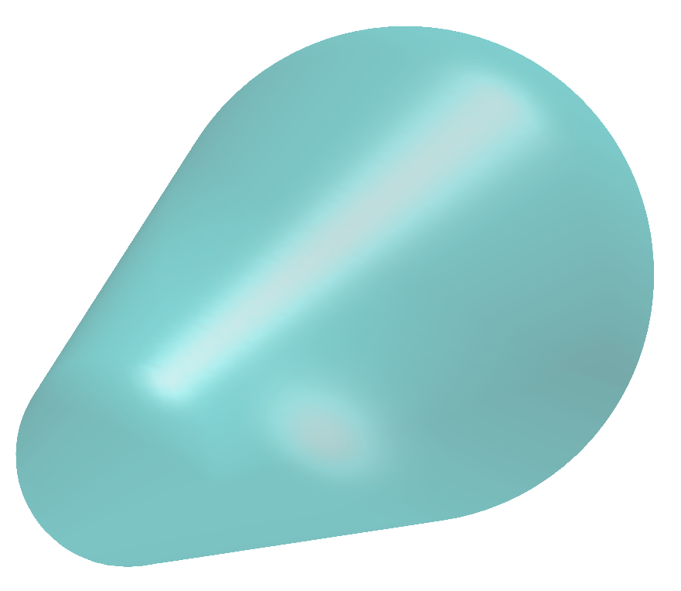

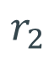
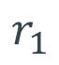
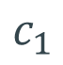
$$c_{1}$$
$$r_{1}$$
$$c_{2}$$
$$r_{2}$$

Slide 6
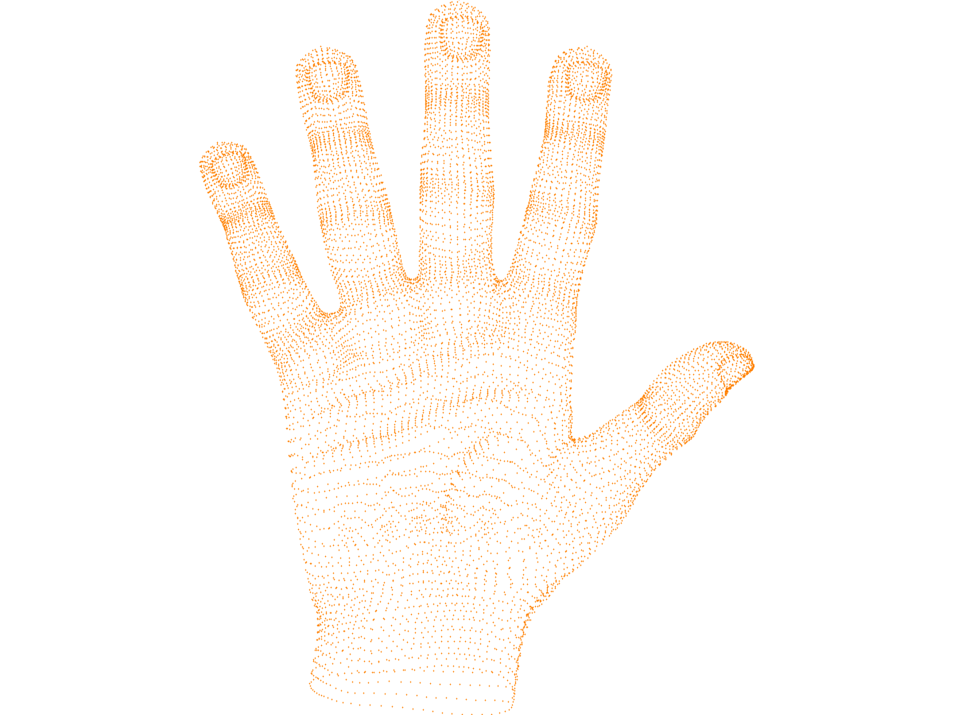
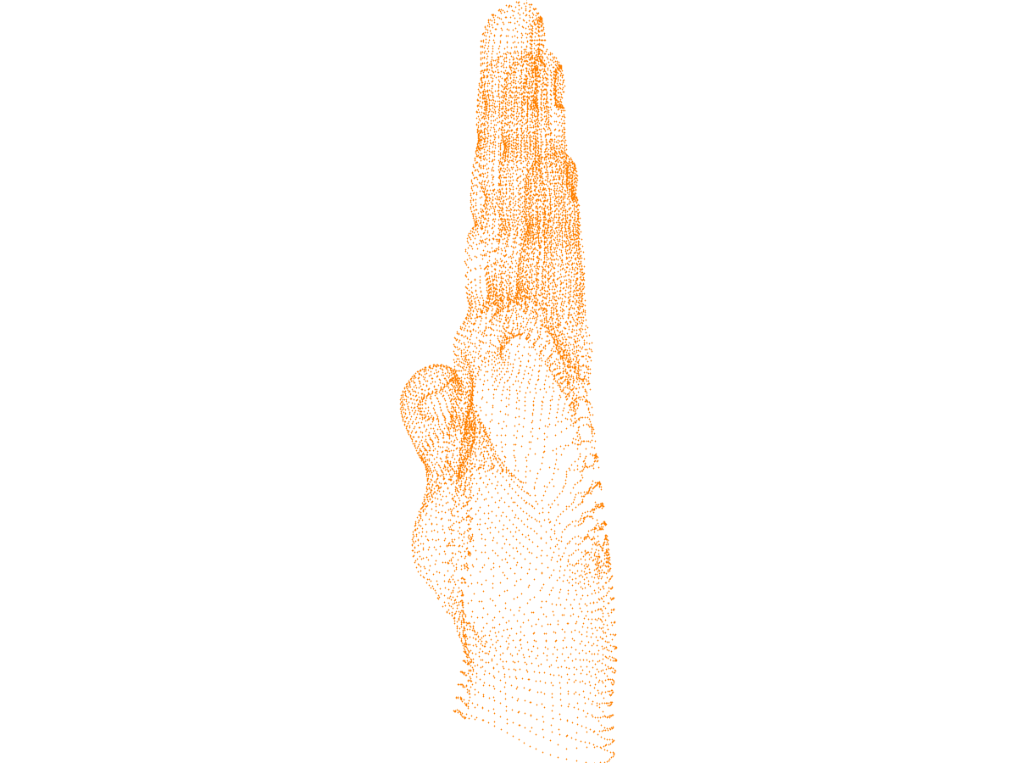

Slide 7
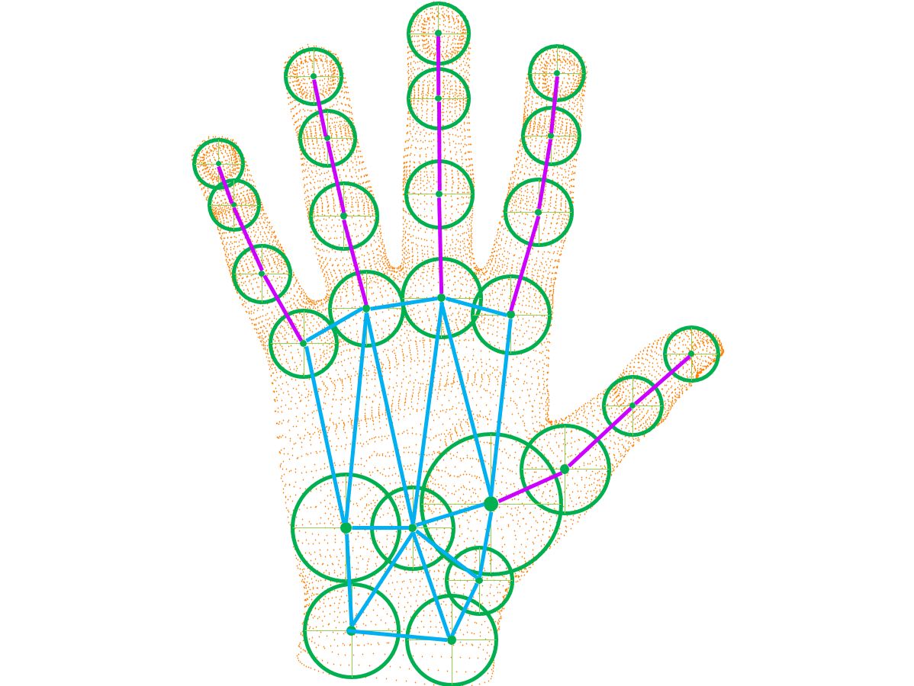
9
5
7
13
4
10
10
6
14
1
9
6
11
12
1
2
15
7
3
8
3
5
11
8
12
2
16
4
17
18
20
13
16
18
17
19
15
19
20
14
21
22
24
21
23
25
22
23
24

Slide 8
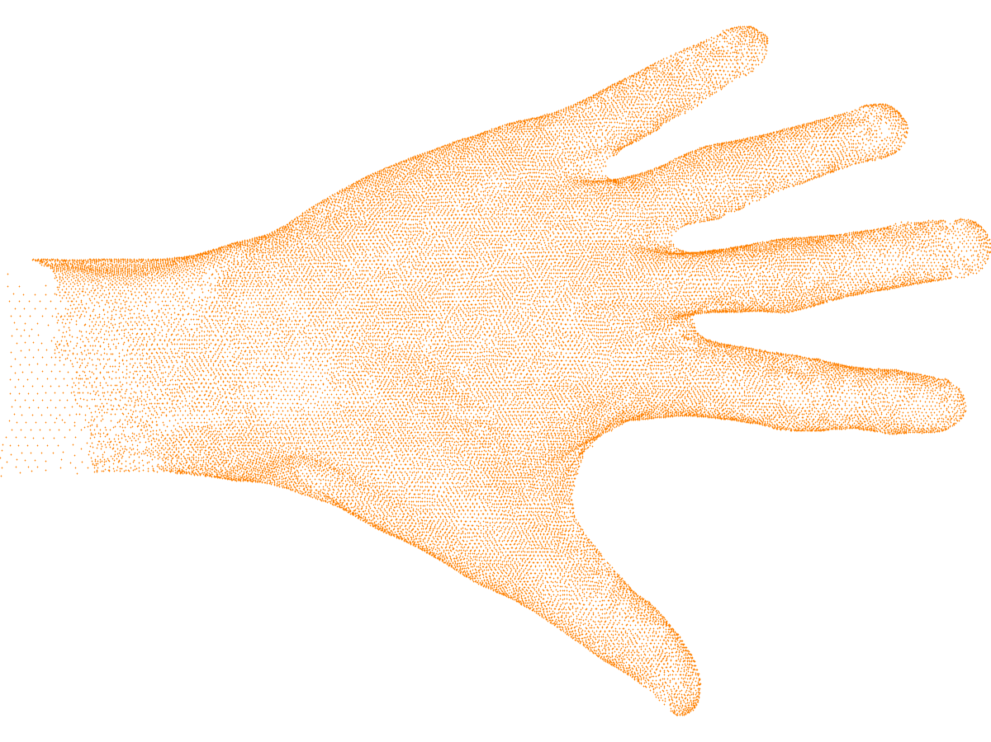
1
2
3
5
4
6
7
8
9
21
11
10
23
12
25
22
16
15
14
13
26
24
20
19
18
17

Slide 9
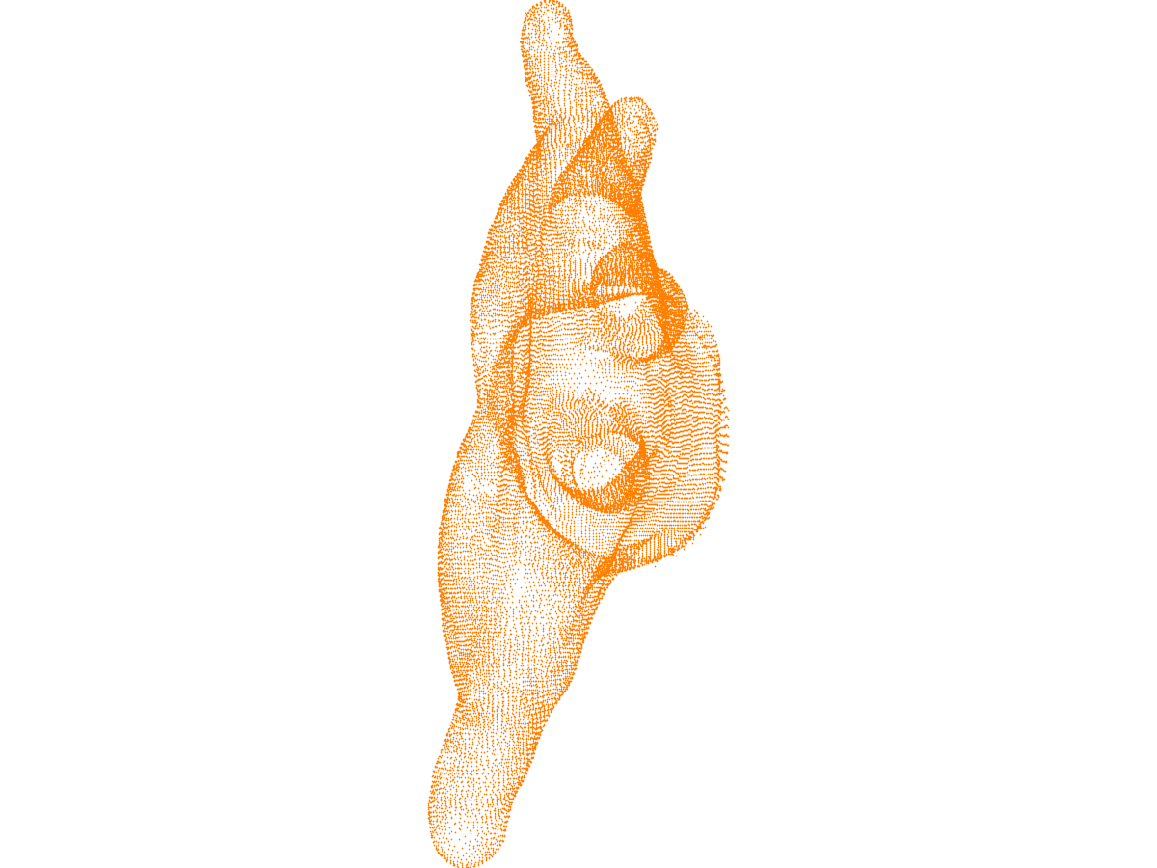

Slide 10
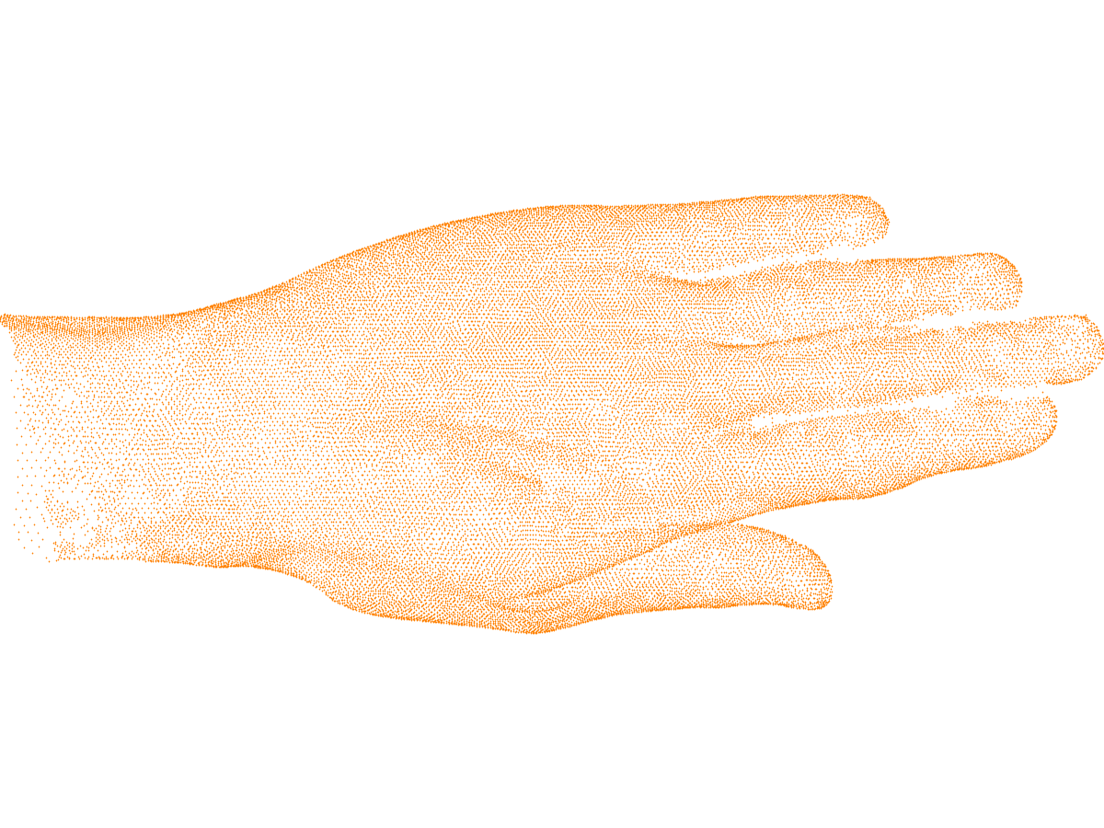
3
2
1
4
6
5
8
7
21
9
11
10
25
23
22
12
13
15
14
16
26
24
20
19
18
17

Slide 11
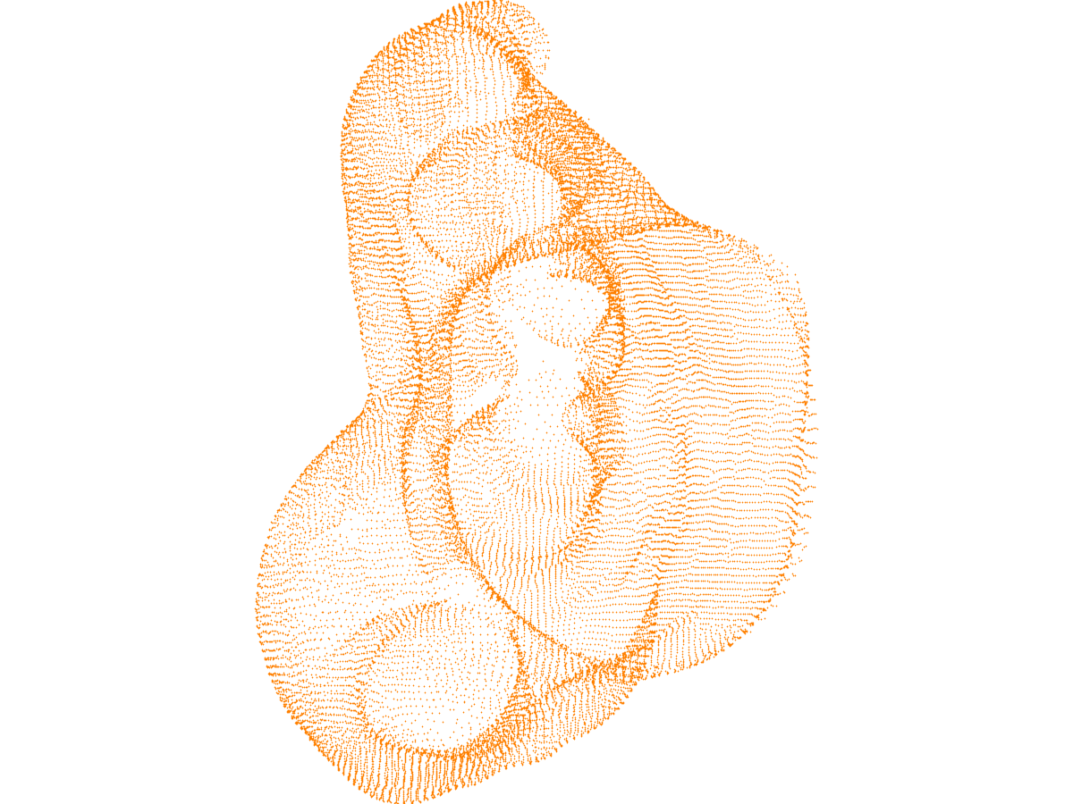

Slide 12
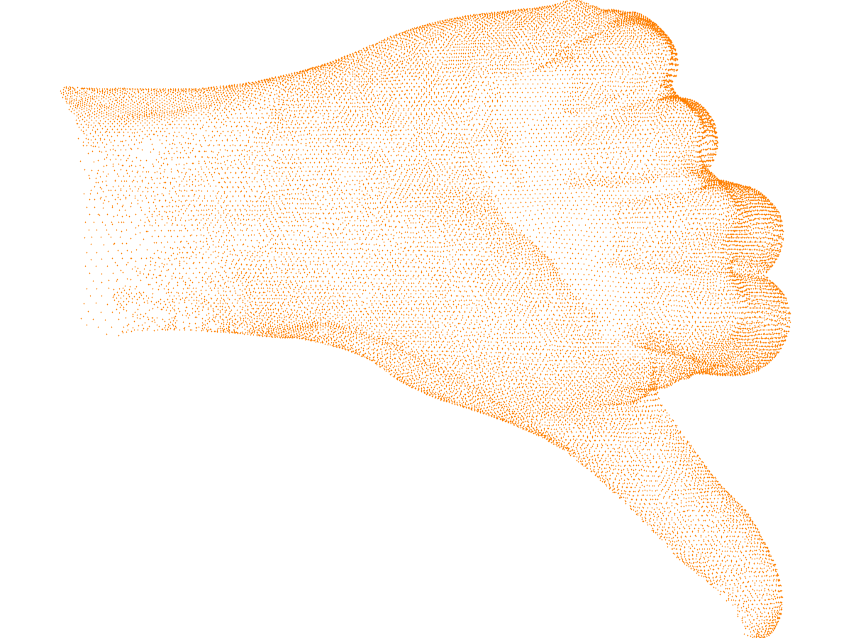
4
3
2
21
1
7
23
8
6
25
5
22
11
12
9
10
26
24
20
13
14
16
15
19
18
17

Slide 13
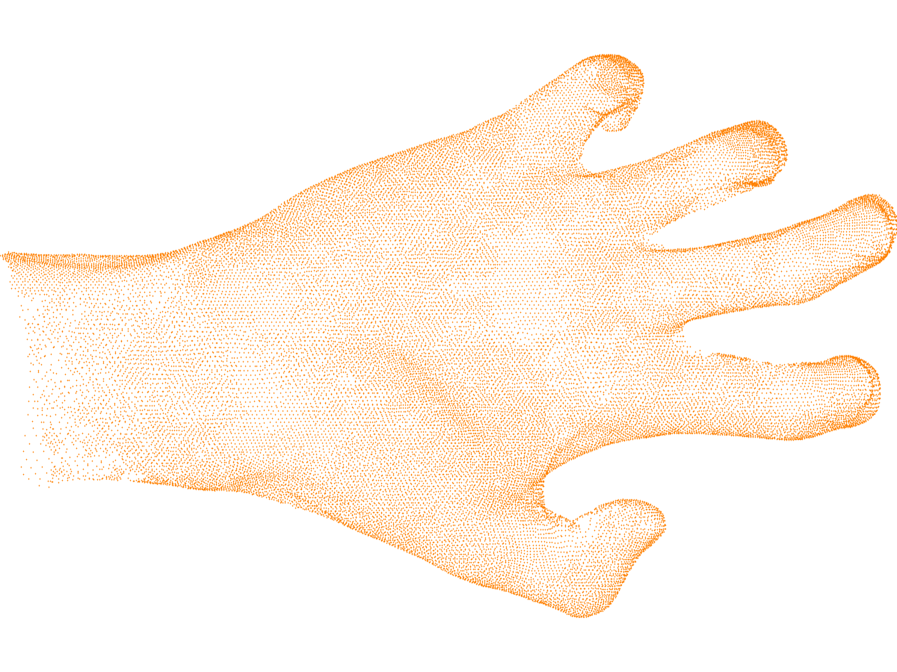
2
3
1
4
6
5
7
8
9
10
21
11
25
23
12
22
16
14
26
15
13
24
20
19
17
18

Slide 14
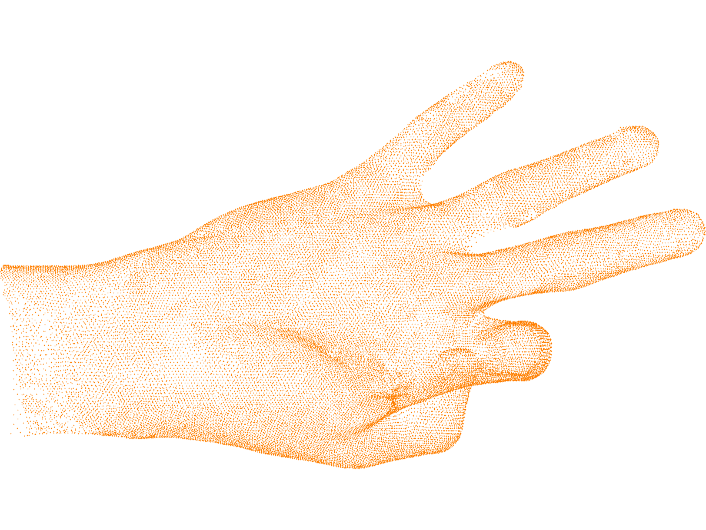
1
2
3
5
6
4
7
8
9
10
21
11
23
12
25
22
16
13
14
15
24
20
17
26
19
18

Slide 15
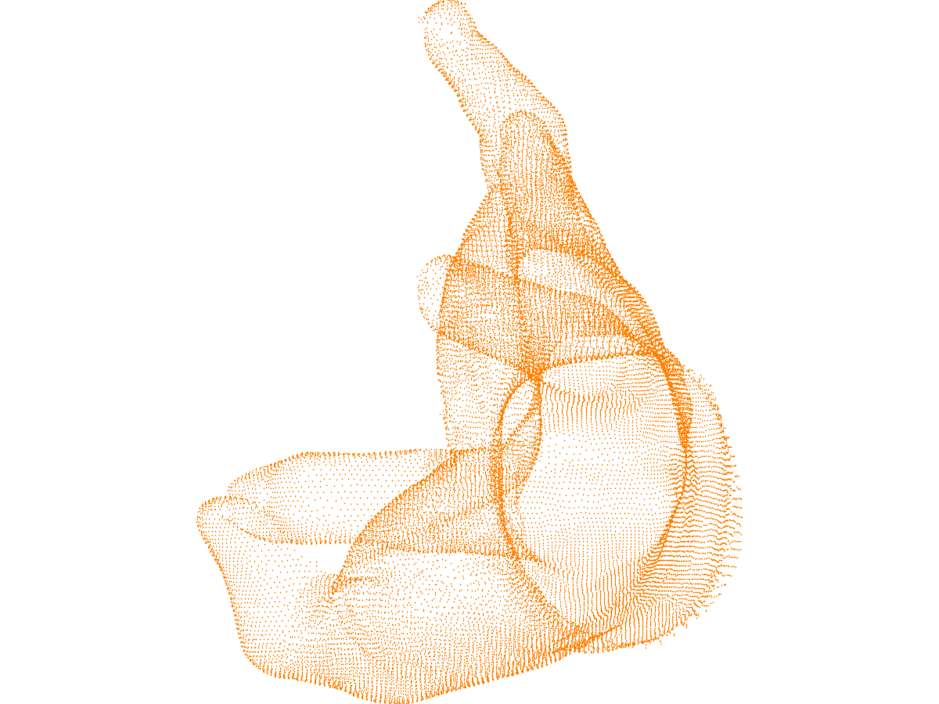

Slide 16
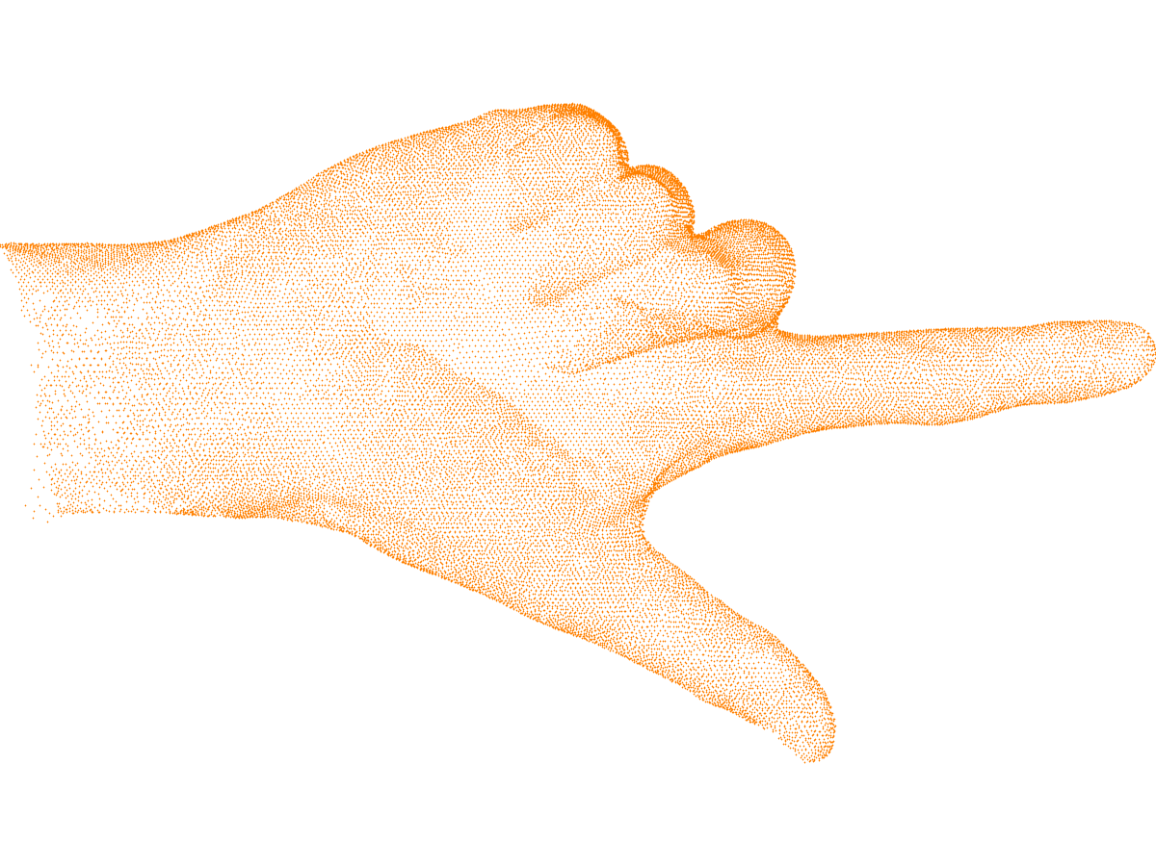
3
4
2
1
6
7
21
8
5
11
23
10
25
12
22
9
13
15
14
16
26
24
20
19
18
17

Slide 17
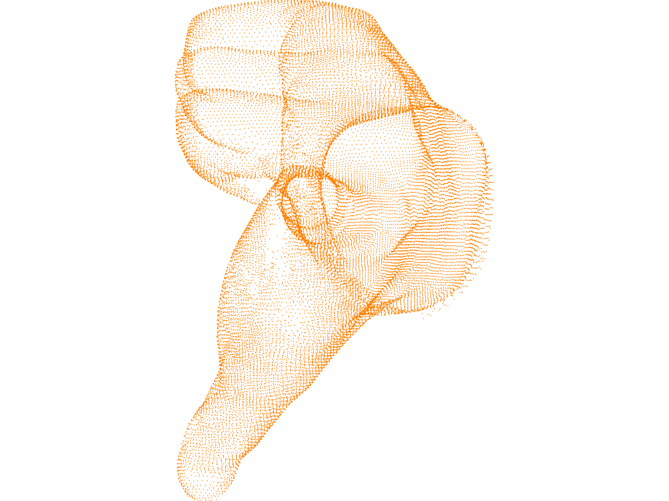

Slide 18
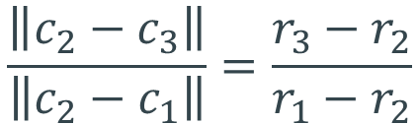
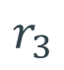
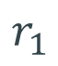
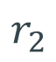
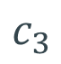
$$r_{1}$$
$$r_{3}$$
$$r_{2}$$
$$c_{1}$$
$$c_{3}$$
$$c_{2}$$
$$\frac{\left\|c_{2}−c_{3}\right\|}{\left\|c_{2}−c_{1}\right\|}=\frac{r_{3}−r_{2}}{r_{1}−r_{2}}$$

Slide 19
Generic pipeline
Hand data
RGBD frame
Modeling
Tracking
Skinning
Hand shape
Hand pose
(High-res) template mesh

Slide 20
Triangular mesh with embedded skeleton (Taylor et. al.)
Hand data
RGBD frame
Modeling
Tracking
Skinning
Vertices and bones positions
Vertices and bones positions
(High-res) template mesh

Slide 21
Spheres/Cylinders model (Tagliasacchi et. al.)
Hand data
RGBD frame
Modeling
Tracking
Skinning
Cylinders size and transformations
Cylinders transformations
(High-res) template mesh

Slide 22
Convolution Surfaces model
Hand data
RGBD frame
Modeling
Tracking
Skinning
Control points positions and radii
Control points positions
(High-res) template mesh

Slide 23
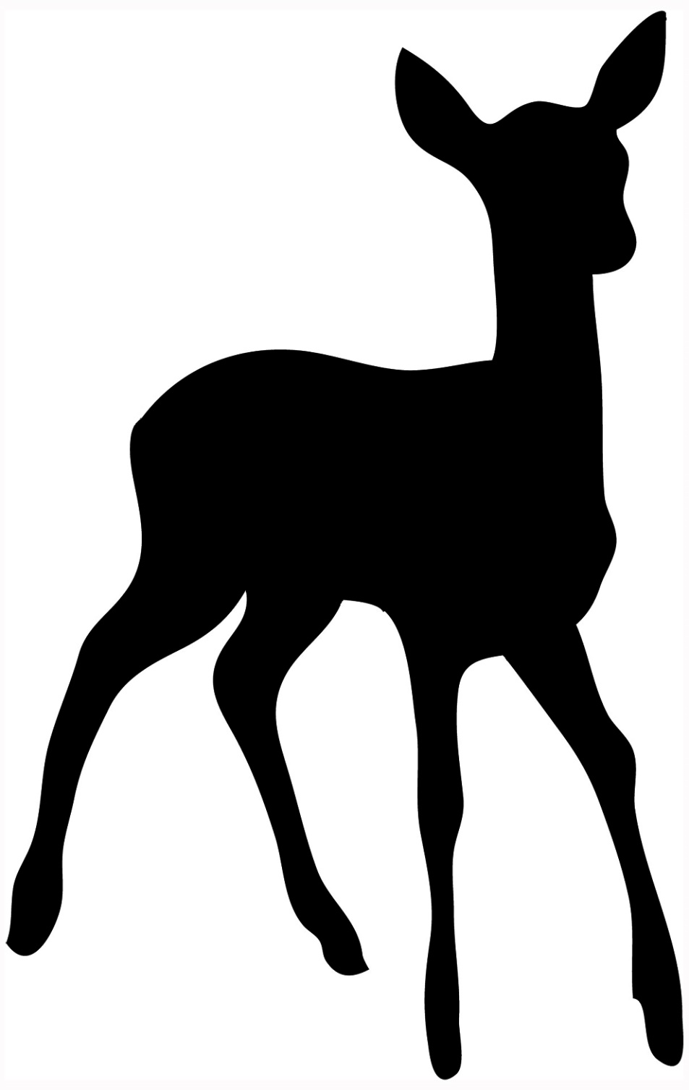
20
22
19
21
18
17
16
15
13
14
12
9
11
3
8
6
2
5
10
7
4
1

Slide 25

15
14
4
3
2
11
5
1
12
13
6
7
8
9
10

Slide 26
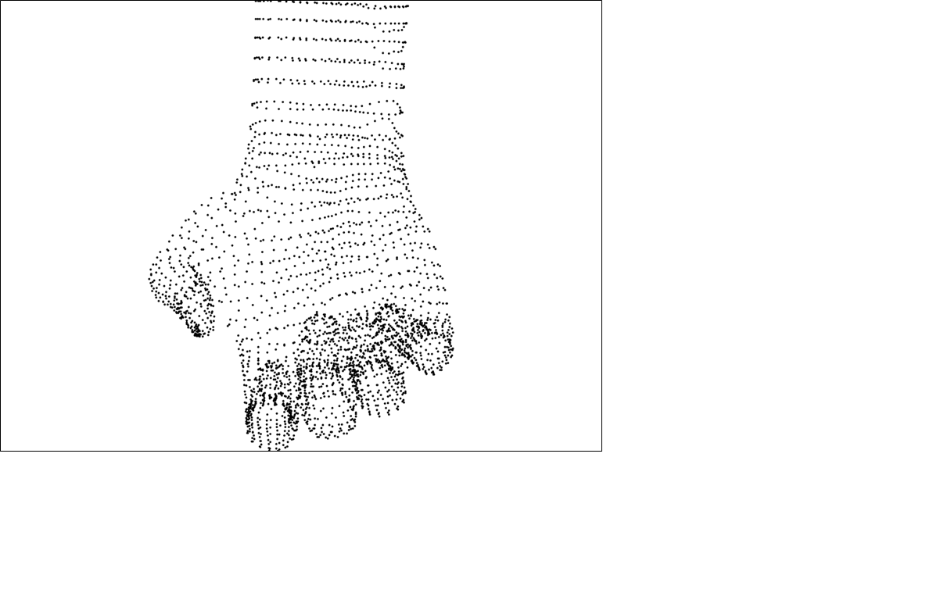
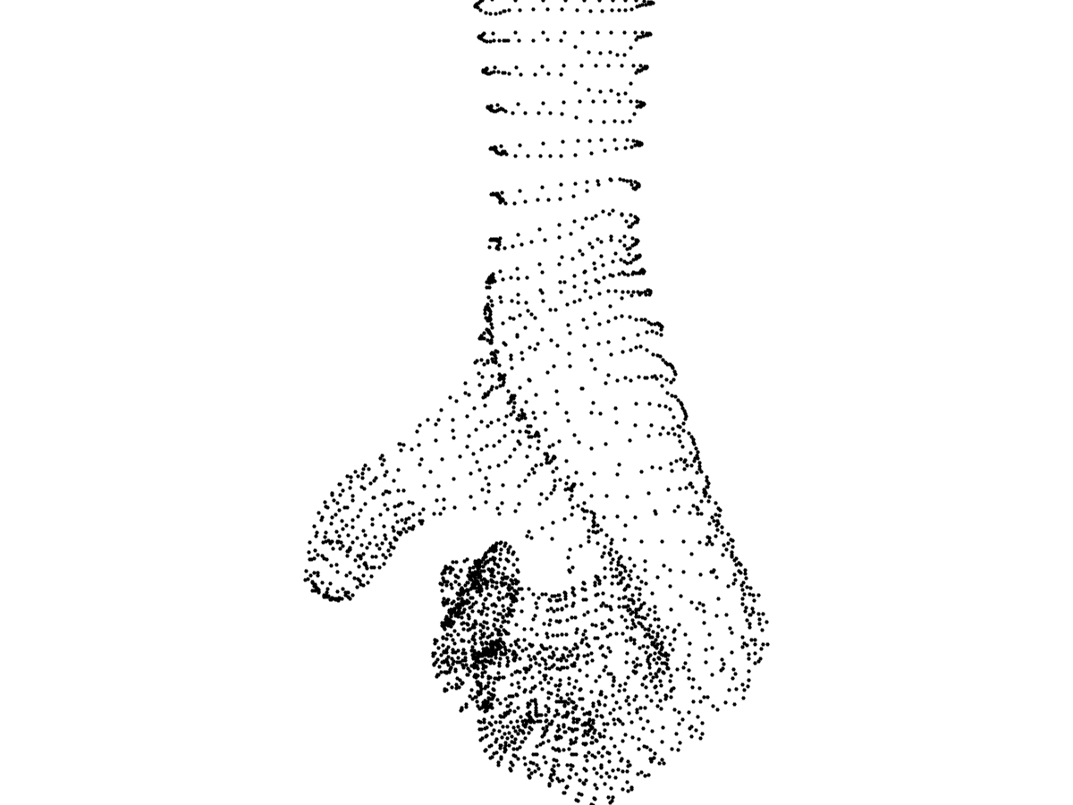
27
26
25
24
20
22
23
19
18
21
28
17
29
4
30
7
16
12
8
1
3
13
9
2
6
14
10
5
11
15

Slide 27
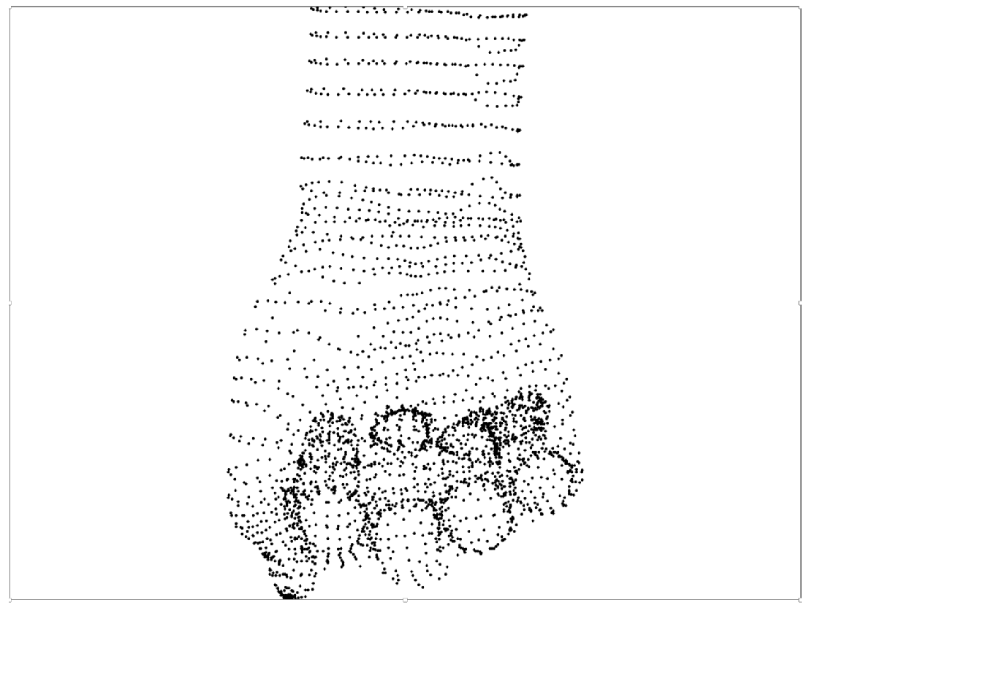
27
26
25
24
22
23
20
19
21
4
16
1
13
9
5
8
2
14
12
6
28
10
29
30
3
18
15
7
11
17

Slide 28
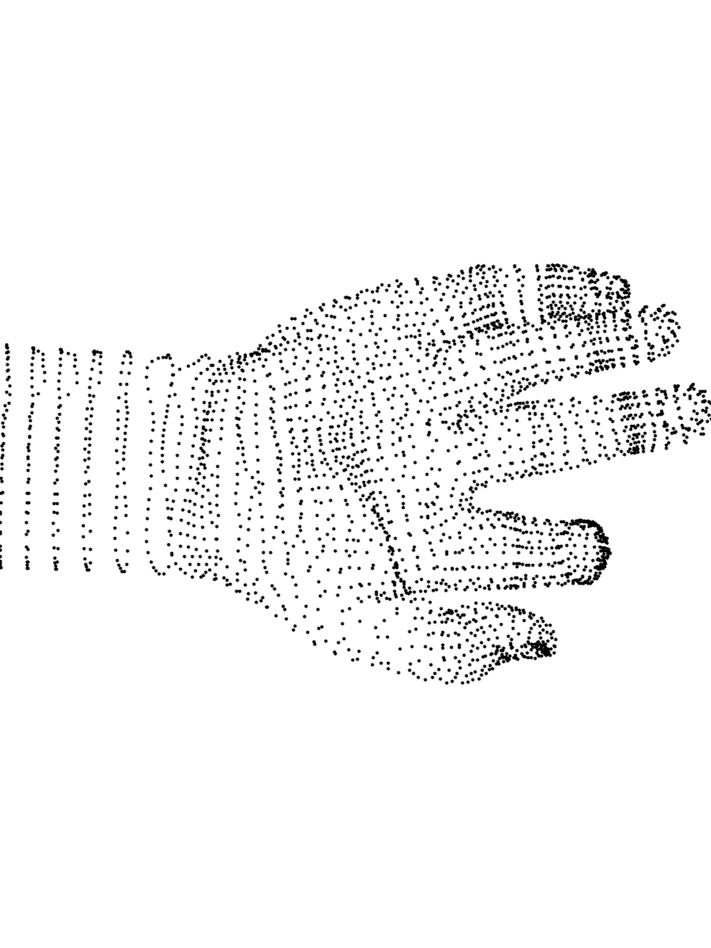
4
28
26
24
23
8
29
22
12
30
27
25
20
16

Slide 29
15
16
9
22
23
8
17
18
1
2
10
11
24
25
3
4
12
13
19
20
29
30
26
27
5
6
37
38
36
31
32
40
21
41
28
14
39
7
33
34
49
43
44
35
42
45
46
47
48

Slide 30
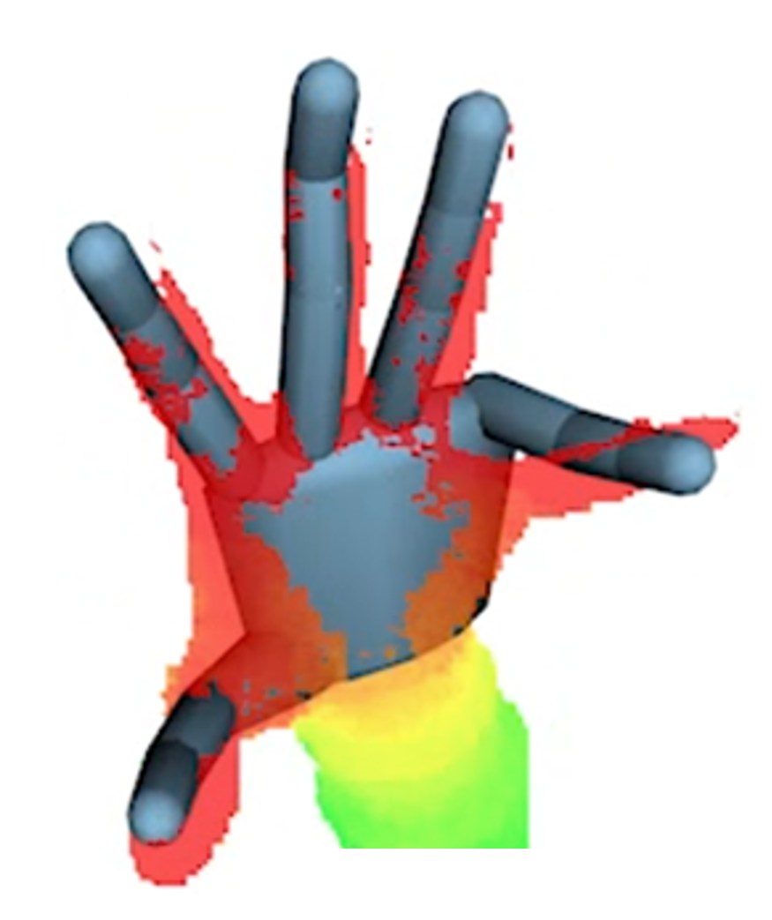
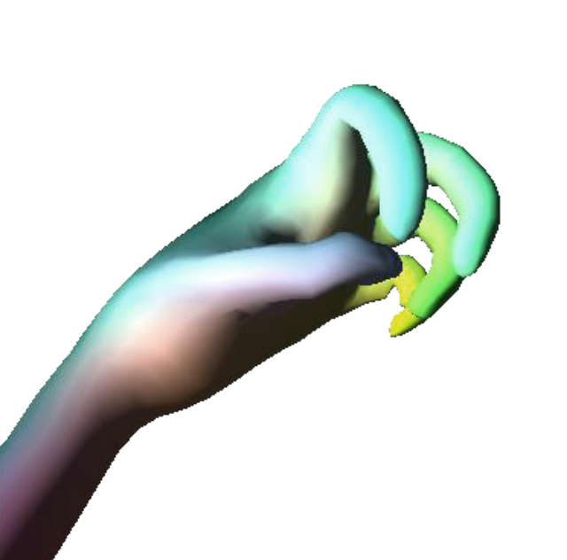

Slide 31
9
5
13
1
10
6
14
2
7
17
11
15
3
29
30
18
28
8
12
16
4
19
23
22
20
24
25
26
27

Slide 32
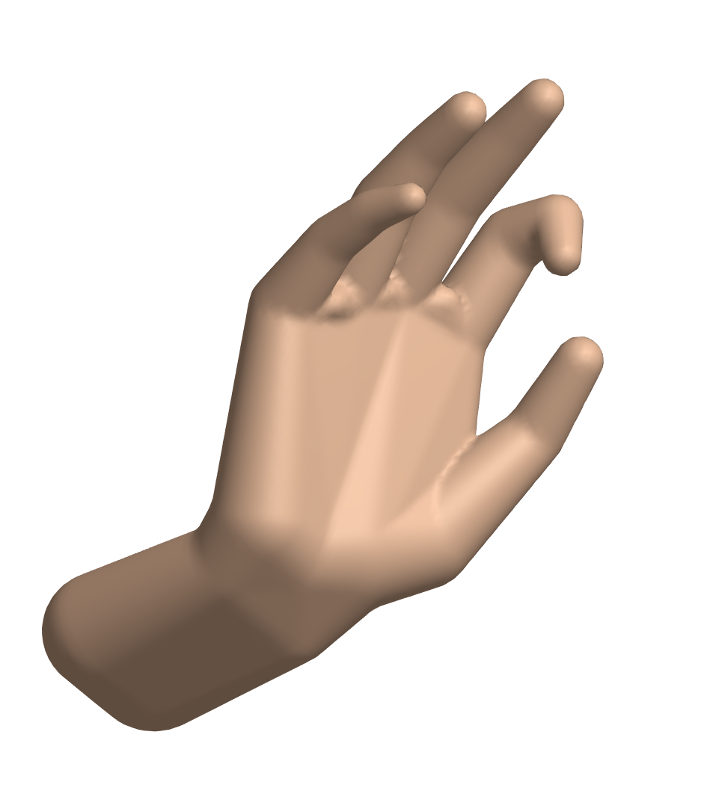
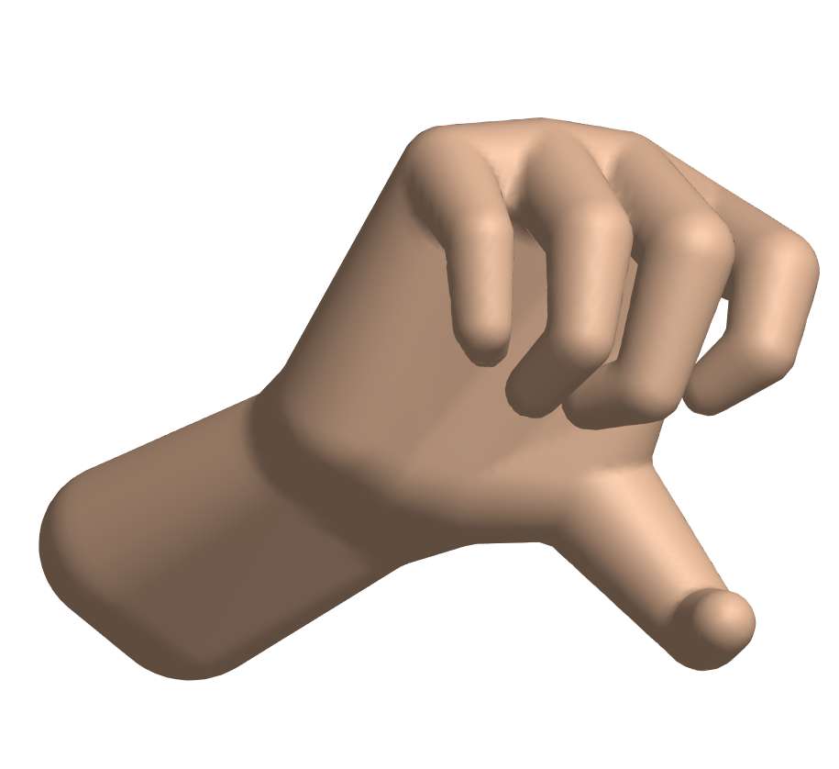
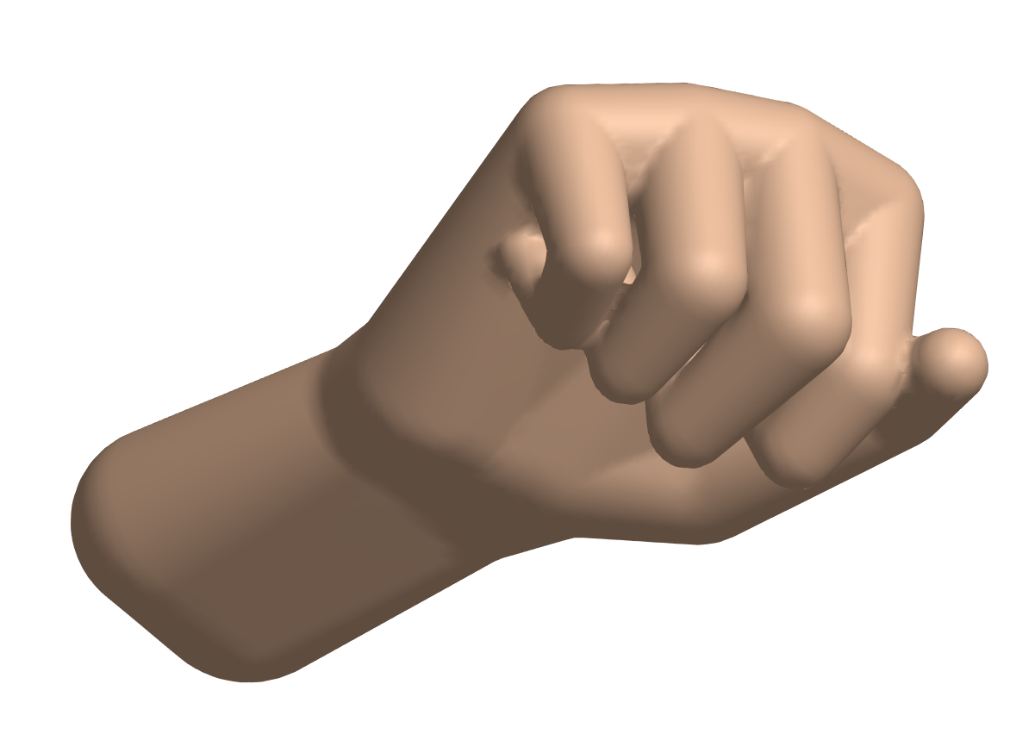
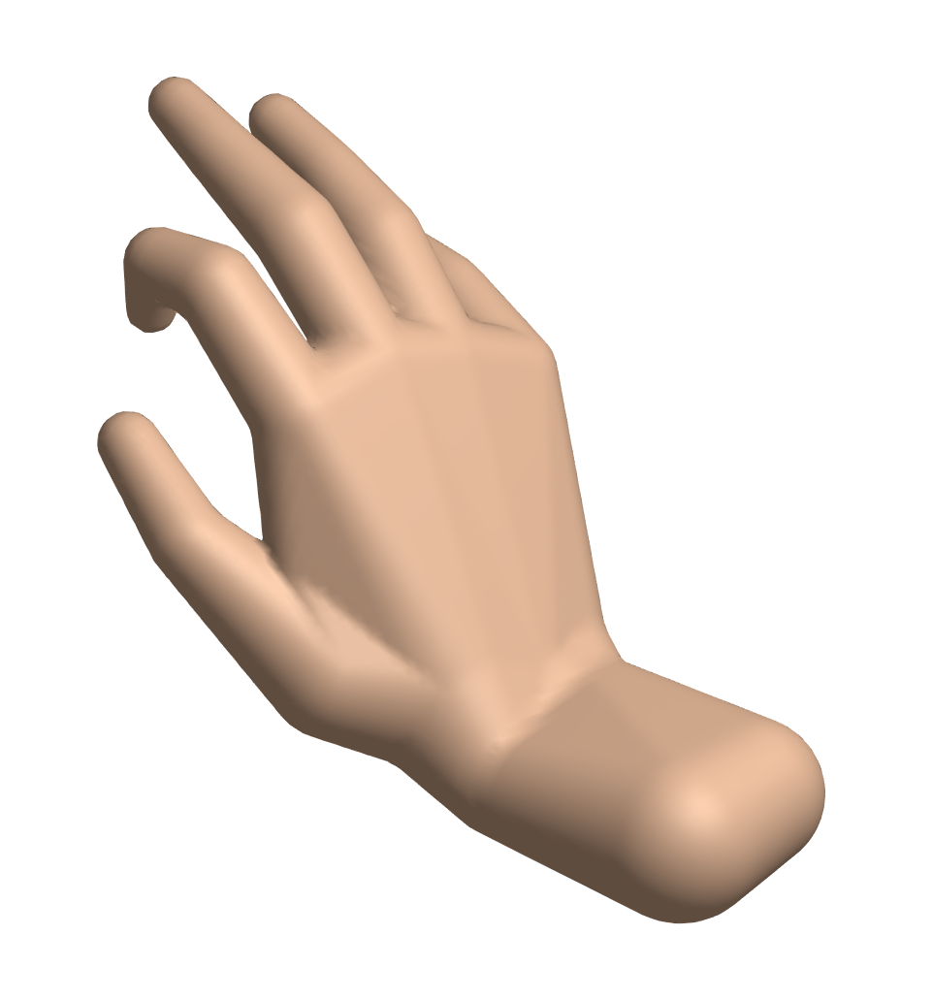



Slide 33
15
8
22
17
18
1
10
11
24
25
3
4
12
13
19
20
29
26
27
5
6
37
38
36
31
32
40
21
41
28
14
39
7
33
34
49
43
44
35
42
45
46
47
48

Slide 34







Slide 35
15
8
22
17
18
1
10
11
3
4
12
13
5
6
36
39
14
7

Slide 36
9
13
5
1
10
14
6
2
15
11
7
3
17
12
16
18
8
4
19
22
23
20
21
24
25
26
27

Slide 37
9
13
5
1
10
14
6
2
15
11
7
3
17
35
36
34
12
16
18
33
8
23
24
4
22
21
25
19
37
27
28
20
26
29
30
31
32

Slide 38
9
13
5
1
10
14
6
2
15
11
7
3
17
35
36
34
12
16
18
33
8
23
24
4
22
21
25
19
37
27
28
20
26
29
30
31
32

Slide 39
9
13
5
1
10
14
6
2
15
11
7
3
35
36
17
34
12
16
33
8
23
24
18
4
22
21
37
25
27
19
28
20
26
29
30
31
32

Slide 40

13
9
7
13
5
10
16
4
10
14
10
6
1
1
15
8
12
5
7
11
9
2
2
15
11
7
6
3
12
9
11
6
3
14
8
5
16
12
8
4
17
21
22
4
13
18
16
3
14
19
1
2
17
15
20
24
23

Slide 41
1
[1, 0, 0]
18
2
[0, 1, 0]
14
22
3
[0, 0, 1]
17
21
26
4
[1, 0, 0]
13
5
[0, 1, 0]
25
6
[0, 0, 1]
16
20
15
19
12
11
24
23
10
[0, 1, 0]
[1, 0, 0]
9
flexion
[0, 0, 1]
7
8
abduction

Slide 42




















$${{R_{b→a}^{T}R}_{b}^{T}R}_{a}a$$
$$a$$
$$a$$
$$a$$
$${{{{\tilde{R}}_{b→a}R}_{b→a}^{T}R}_{b}^{T}R}_{a}a$$
$$b$$
$$b$$
$$b$$
$$b$$
$$b$$
$$a$$
$$a$$
$${R_{b}^{T}R}_{a}a$$
$$R_{a}a$$
$${{{{R_{b}\tilde{R}}_{b→a}R}_{b→a}^{T}R}_{b}^{T}R}_{a}a$$
$$(a)$$
$$(b)$$
$$(c)$$
$$(d)$$
$$(e)$$

Slide 43






$$p$$
$$q$$
$$c_{2}$$
$$s$$
$$c_{1}$$

